Slide 1
International Students
Non-Resident
Income Tax Seminar
for 2014 Taxes

Slide 2
This workshop is for students on
F-1 visas who have been in the U.S. for 5 years or less and students on
J-1 visas who have been in the U.S. for less than 2 years
Please Note

Slide 3
Internal Revenue Service
The taxation agency of the United States Government to which you
  Report your immigration status
  File* your personal Income Tax Return
*IRS uses the word “file” to mean submit or send. To “file” your return means to send it to IRS by the US Postal Service. Non-Resident tax returns CANNOT be e-filed.

Slide 4
“State” Tax Returns
If you lived in another State (not Texas) you may need to file that State’s Income Tax Return
If you lived in two other States you may need to file two State Income Tax Returns

Slide 5
Basic Tax Vocabulary
Alien: any person who is not a U.S. citizen or US Permanent Resident
Student: person temporarily in the U.S. on an F, J, Q or M visa
Teacher or Trainee: person who is not a student & who is temporarily in the U.S. on a J or Q visa

Slide 6
Basic Tax Vocabulary (cont.)
Compensation/Earnings: wages, salaries, tips
Income: wages, salaries, tips, dividends, some scholarship/fellowship grants
IRS: Internal Revenue Service
Income Tax Return: a reconciliation statement filed (submitted) by individual taxpayers to the IRS

Slide 7
Who Must File
2014 Forms with the
Internal Revenue Service?

Slide 8
All individuals temporarily in the U.S. on a F-1 or J-1 visa (and dependents) must file (a) form(s) with the
Internal Revenue Service.

Slide 9
Which form(s) must you file?

Slide 10
ALL INDIVIDUALS in the U.S. on Student visas for 5 years or less or J-1 visas for 2 years or less (plus dependents)
MUST file
Form 8843
”Statement for Exempt Individuals and Individuals with a Medical Condition”

Slide 11
Exempt Individual?
What does Exempt Individual mean?
  It means a person who is exempt from counting days for the Substantial Presence Test
  It does not mean exempt from taxes

Slide 12
Substantial Presence Test
What is the Substantial Presence Test?
  It is the IRS methodology for determining if an alien is a resident or non-resident for tax purposes.

Slide 13
What about F-1/J-1 students & J-1 scholars who did not earn any U.S. income in 2013?
They do not have to pay taxes, but they must send a form 8843 to the IRS.

Slide 14
Completing the 8843
Go to http://www.irs.gov/
Click on Forms and Pubs tab
Click on blue bar
Type 8843 in search box
Current
Forms and Pubs

Slide 15
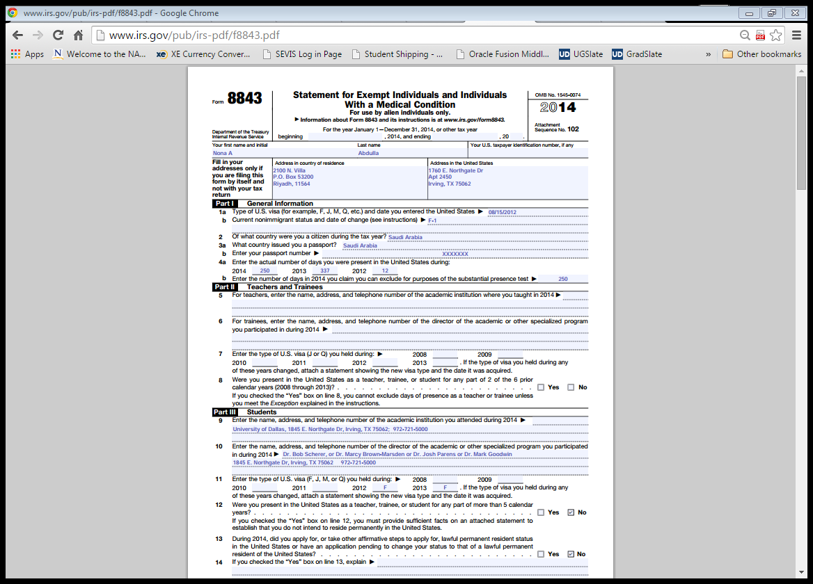

Slide 16
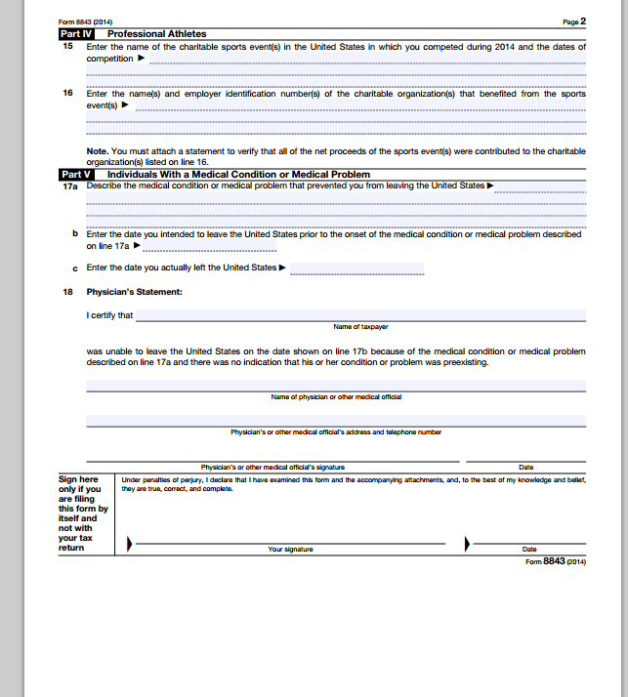
Nona A Abdulla 3/6/2015

Slide 17
Non-Resident Tax workshop
If you have no other income – no wages, no contract income, no scholarship, no gambling winnings, no dividends on investments, no royalty income, no other income from US sources - this is the only form you have to complete, print and mail to IRS.
Mail Form 8843 to:
  Department of the Treasury
  Internal Revenue Service Center
  Austin, TX 73301-0215
Mail no later than June 15.
If you do have other income, the 8843 will be sent with the 1040 form that we will learn about next.

Slide 18
Non-Resident Tax workshop
You are free to leave
Thank you for coming

Slide 19
What about F-1/J-1 students who received only a scholarship or fellowship grant in 2013?

Slide 20
F-1/J-1 Students: Scholarship or Fellowship Grant Only
Scholarship and fellowship grants are not included in taxable income IF they cover ONLY tuition, fees, books, supplies and equipment required for courses AND if the student is pursuing a degree.
Any portion of scholarship or fellowship received for room & board OR received in exchange for teaching or research IS taxable income.

Slide 21
What is a Scholarship or Fellowship?
You call it:
Tuition Waiver
Non-taxable Scholarship
(No work required)
Internal Revenue
calls it:

Slide 22
What is a Scholarship or Fellowship?
You call it:
Room and Board
Waiver
Internal Revenue
calls it:
Taxable Scholarship

Slide 23
What is a Scholarship or Fellowship?
Teaching, Research or Graduate Assistant or Student Worker
(recipient performs work)
You call it:
Internal Revenue
calls it:
Taxable Wages

Slide 24
What do I file if I have a scholarship, but it covers only tuition so I don’t have to pay taxes on it?
File Form 8843

Slide 25
What do I file if I have a scholarship that covers tuition, room and board?
File Form 8843
AND
Form 1040NR OR 1040NR-EZ

Slide 26
What do I file if I have a scholarship I must pay tax on and can also claim a tax treaty benefit on that scholarship?
File Form 8843 and
Form 1040NR OR 1040NR-EZ

Slide 27
What do I file if I have on-campus employment (assistantship, student worker, food service, etc) wages?
File Form 8843
AND maybe
Form 1040NR OR 1040NR-EZ
(Depends on the total amount earned and whether any money was withheld for possible taxes)

Slide 28
Income Reporting Forms
W-2: End of Year statement from employer showing total wages paid and taxes withheld during the year
1099- Misc: End of year statement from employer to an independent contractor – no taxes withheld
1042-S: “Foreign Persons U.S. Source Income Subject to Withholding” form
  Issued by scholarship source to report scholarship, amount covered by a tax treaty, and possible withholding of taxes
Letter from scholarship source (university business office) showing scholarship < or = tuition

Slide 29
Forms W-2, 1099-Misc & 1042-S
You could have one or more of these forms.
The form was prepared by your employer and mailed to you.
You do not write anything on these forms.
You use these forms as a reference when you prepare your income tax return.
When finished, you attach this form(s) to your income tax return.

Slide 30
The 1099 – Misc
Statement of amounts paid to independent contractors (known as non-employee compensation in IRS terminology).
Compensation you receive that is reported on a 1099 - Misc is taxable income. However, your employer has not done any withholding for income taxes.

Slide 31
More Tax Vocabulary
Withholding:
  The amount that is automatically taken from your paycheck in “anticipation” of your tax obligation
U.S.-Source Income:
  All income, gain or loss from U.S. sources

Slide 32
Tax Return Forms
As stated earlier, a US tax return is a reconciliation statement completed by individuals and sent to the IRS.
1040NR: U.S. Non-resident Alien Income Tax Return (the long form)
1040NR-EZ: U.S. Income Tax Return for non-resident aliens who have no dependents (the short, easy to complete form)

Slide 33
When is the 1040-NR or 1040-NR EZ not required?
You do not need to file a form 1040-NR or 1040-NR EZ if:
You have only taxable U.S. Source Wages that were less than $3,950 – (no tax liability) AND
No money was withheld from your paycheck that you want refunded to you.

Slide 34
Should you complete the
Form 1040NR or 1040NR-EZ?
You’ve decided you must complete a 1040 Form
The answer will depend upon your situation and some choices you make. First, learn the following tax vocabulary . . .

Slide 35
Deductions
If you made specific payments* or had specific expenses* during 2014,
*(shown on next slide)
AND
choose to reduce your taxable income by claiming itemized deductions, then you must use the Form 1040NR

Slide 36
More Tax Vocabulary (cont.)
What payments you made or expenses you had during 2014 can you itemize?*
Deductions are permitted for state and local income taxes**, charitable contributions, casualty losses, job expenses and other miscellaneous deductions. See Form 1040NR and instructions for specific details.
*Most students do not itemize
**Since Texas does not have a state income tax, you are not able to claim this deduction

Slide 37
More Tax Vocabulary (cont.)
Personal or Standard Exemption
an amount you do not have to pay taxes on
Everyone (residents and non-residents can claim this)
For 2014, the amount is $3,950
If this is the only reduction to taxable income that you can claim, you can use the Form 1040NR EZ.
[A few tax treaties (Canada, Mexico, Japan, Korea and India) permit exemptions for dependents in certain VERY limited cases. ]

Slide 38
I have heard there is a Standard Deduction. What is that?
Standard Deduction
A base amount of income that is not subject to income tax
However, the Standard Deduction is available only to resident tax payers and citizens of India filing non-resident taxes
($6200 for 2014)

Slide 39
PLEASE NOTE
Unless you are an Indian student, you are only eligible for the “Itemized” Deductions allowed on the 1040NR and the Standard Exemption.
Only Indian students are eligible for a Standard Deduction and a Standard Exemption.

Slide 40
What are the exemptions for spouses and children?
There are only a few (about 5) countries whose tax treaties with the US allow for exemptions for dependents. Most students will NOT be able to reduce their taxes based on expenses they incur to support dependents

Slide 41
Spousal Exemptions available for some Non-Residents
Married individuals from Canada, Mexico or the Republic of South Korea
Married individuals from Japan if they choose to apply the old treaty rules
Married individuals who are students and are from India

Slide 42
Exemptions for Children for some Non-Residents
Individuals from Canada, Mexico or South Korea can claim children who live with them as dependents.
Individuals from Japan may claim children who live with them as dependents if they choose the old treaty rules.
Individuals from Canada and Mexico can also claim children who don’t live with them as dependents.
Students from India may be able to claim exemptions for children.

Slide 43
Is any non-resident income exempt from taxes?
Yes, but only some categories of income . . .

Slide 44
Non-Resident Income Exempt from Taxes
(Not connected with a trade or business)
Interest:
  Bank Deposits (including Certificates of Deposit)

Slide 45
Tax Treaty Exemptions
Some countries have Tax Treaties with the U.S. that allow their residents to earn some money while temporarily in the U.S. without being subject to US income tax on those earnings. See IRS Publication 901 for details.

Slide 46
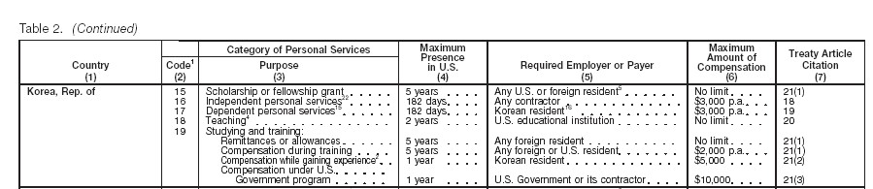
Sample Tax Treaty
South Korean tax treaty as it appears in Publication 901 Note the words in boxes

Slide 47
Tax Treaties – Amounts and Treaty Articles as of 2013
Bangladesh $8,000 21(2)
Belgium $9,000 19(1)(b)
Bulgaria $9,000 19(1)(b)
China $5,000 20(c)
Cyprus $2,000 21(1)
Egypt $3,000 23(1)
Estonia $5,000 20(1)
France $5,000 21(1)

Slide 48
Treaty Amounts and Articles cont’d
Germany $9,000 20(4)
Iceland $9,000 19(1)
India Standard Deduction 21(2)
Indonesia $2,000 19(1)
Korea $2,000 21(1)
Latvia $5,000 20(1)
Lithuania $5,000 20(1)
Morocco $2,000 18

Slide 49
Treaty Amounts and Articles cont’d
Netherlands $2,000 22(1)
Norway $2,000 16(1)
Pakistan $5,000 XIII(1)
Philippines $3,000 22(1)
Poland $2,000 18(1)
Portugal $5,000 23(1)
Romania $2,000 20(1)
Slovak Republic $5,000 21(1)

Slide 50
Treaty Amounts and Articles cont’d
Slovenia $5,000 20(1)
Spain $5,000 22(1)
Thailand $3,000 22(1)
Trinidad & Tobago $2,000 19(1)
Tunisia $4,000 20
Venezuela $5,000 21(1)

Slide 51
Summary: Which non-residents can use Form 1040NR-EZ?
Individuals who do not claim any dependents
    (This will be most international students)
Individuals whose taxable income is less than $100,000
Individuals who do not claim any itemized deductions
Individuals who received only wages, tips and scholarship or fellowship grants
Miscellaneous other reasons (see Publication 519)

Slide 52
Let’s look at the steps for completing
Form 1040NR-EZ
(3 Examples of F-1 students’ Form 1040NR-EZ)

Slide 53
1040NR EZ
Access 1040NR EZ on IRS website
http://www.irs.gov/pub/irs-pdf/f1040nre.pdf

Slide 54
Example 1 – no treaty
Name: Can Gurek
Citizen of Turkey – no tax treaty
F-1 student in US since August 1, 2012
Employed on campus in 2013 and 2014
Went home once in 2013 – gone 17 days
Went home once during 2014 – Left 05/10/14 returned 8/15/14; gone 106 days
Earned $6427 in 2014; $355 was withheld by employer toward income taxes

Slide 55
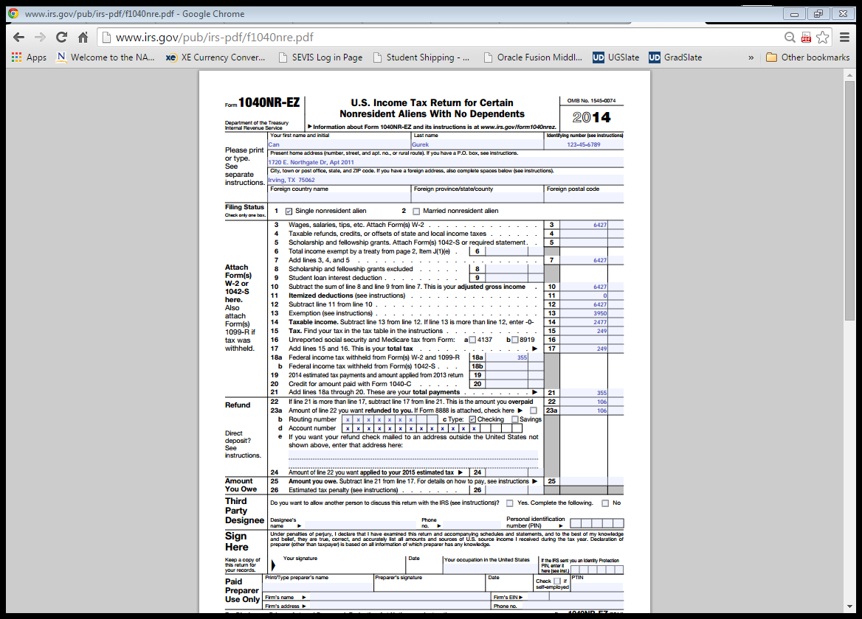

Slide 56
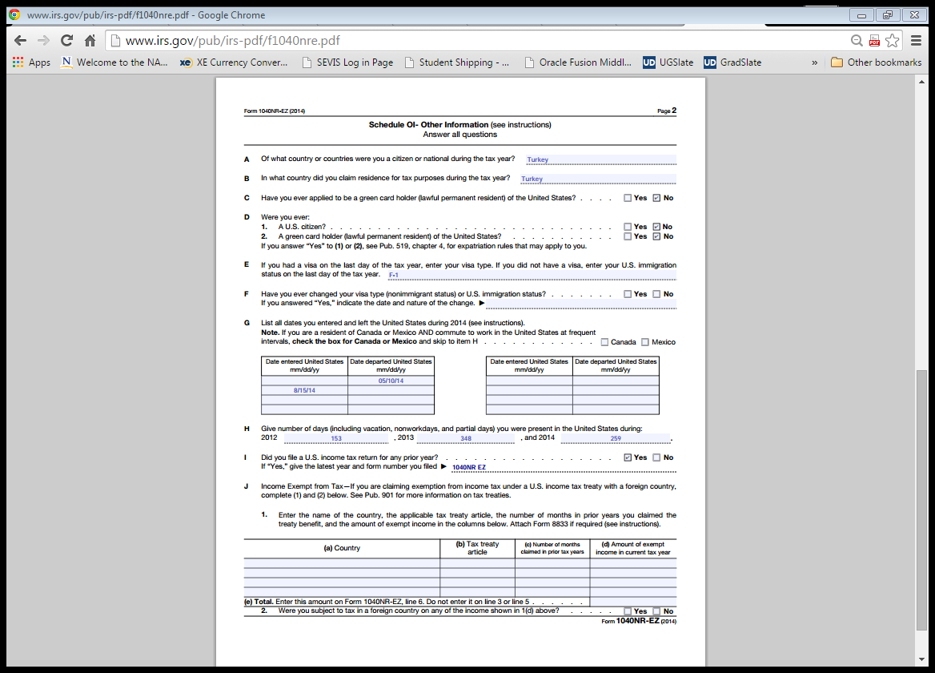

Slide 57
Example 2 – with treaty
Name: Ricardo Gomez
Citizen of Venezuela – Tax treaty available
F-1 student in US since December 22, 2012
Employed on campus in 2013 and 2014
Went home 2 times – Left 12/04/13; returned 1/20/14 – Left 8/06/14; returned 8/20/14
Earned $10,762 in 2014; $592 was withheld by employer toward income taxes
US/Venezuela tax treaty - $5000

Slide 58


Slide 59
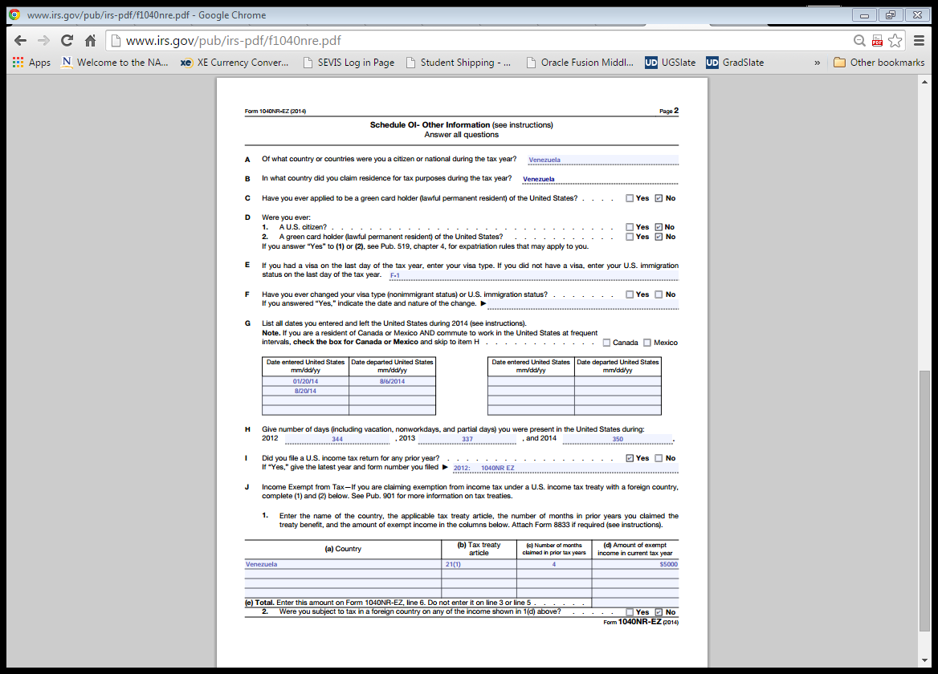

Slide 60
Example 3 – Indian Citizen
Name: Rupali Chandra
Citizen of India – Tax treaty available
F-1 student in US since December 22, 2012
Employed on campus in 2013 and 2014
Went home once – Left 11/18/13; returned 1/08/14;
Graduated 04/25/14; Employed on OPT 2014
Earned $1080 in 2014 from on-campus job;
Earned $26,250 from OPT employer
A total of $2733 was withheld by both employers
US/India tax treaty – permits claim of stnd deduction

Slide 61
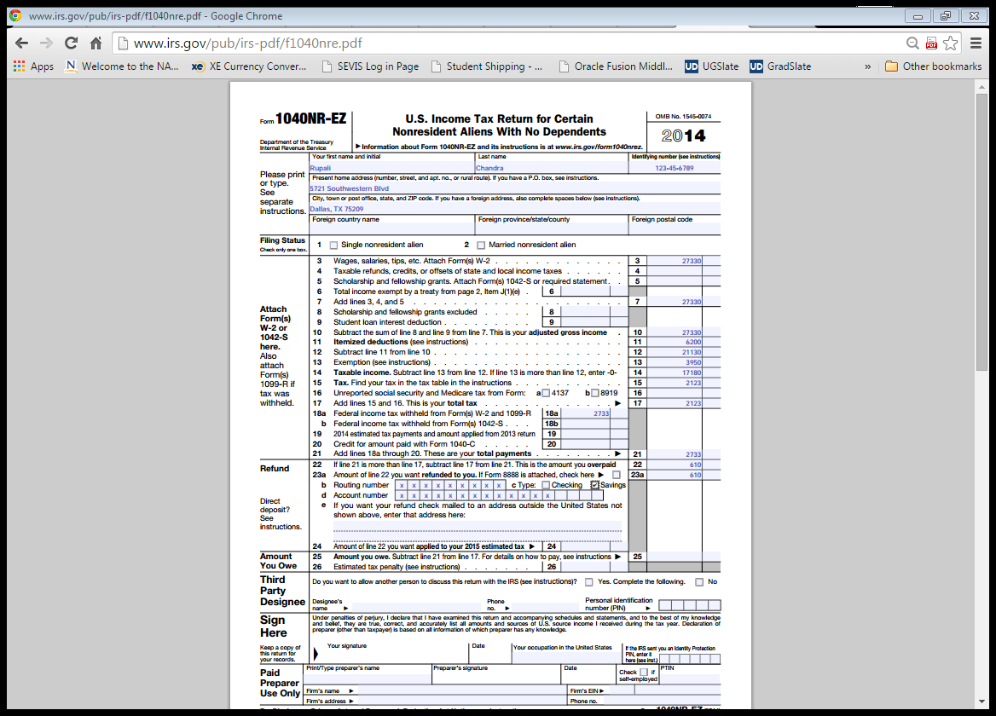
Write in
Standard deduction allowed by US/India Income Tax Treaty

Slide 62


Slide 63
Printing and Mailing IRS Forms
Print the 8843 and the 1040NR forms
Mail by US Postal Service
Print/Save a file copy for yourself so next year you can go back and see what you did this year. Keep your file copies; you might need them in future to show you complied with US tax laws.

Slide 64
Printing and Mailing IRS Forms (con’d)
Attach a copy (or copies) of your W-2’s and/or 1042’s to your 1040 form. 1099 – Misc doesn’t have to be included, but might be a good idea to include it anyways.
If you need to pay any taxes, ENCLOSE a check but do not attach it to the 1040 form – no staples, no paper clips.

Slide 65
Where do I send non-resident income tax returns?
Internal Revenue Service
Austin, Texas 73301-0215, U.S.A
What do I send?
The 1040NR EZ or the 1040NR
(with your W-2(s) attached)
AND the 8843

Slide 66
What is the filing deadline for a non-resident income tax return?

Slide 67
The Filing Deadline is
April 15, 2015

