Slide 1
What you need to know for Banner 9
Human Resources Focus
Notes:
This deck goes over what is good to know about Banner 9 for Human Resources professionals.

Slide 2
Benefits of Banner 9
Improved user experience
Modern, yet familiar, web user interface with standard controls
Shorter learning curve for occasional users
Enhanced usability and navigation for power users
Ability to run in any modern browser
Significant reduction in time & cost to maintain Banner
Ellucian Solution Manager
Simplifies the upgrade process
Minimizes system interruptions and risk
Reduces time and cost for installation and deployment
Less user testing required
Modifications replaced with configurations and extensions – eliminates maintenance with upgrades, reduces testing required

Slide 3
Benefits of Banner 9
Improved Student and Faculty Experience
Student Advising Profile – saves times for students and advisors, enables personalized advice for better academic decisions
Attendance tracking empowers faculty, saving time for registrars and financial aid
Faculty Grade Entry streamlines grade processing including the ability to enter grades via spreadsheet
Registration
More intuitive, saving time for registrar and the IT office
Seamless integration with Ellucian DegreeWorks
Enables advisors to better plan their student’s success
Better visibility into course demand for registrars

Slide 4
Benefits of Banner 9
Self Service modules reduce administrative burden
Employee Profile provides more self-service information for employees saving time for HR
Position Description saves time in creation, editing, routing and approval of positions and makes posting to job search sites faster and more efficient
Direct Deposit for staff and students reduces manual effort for employees, students and internal staff
Purchase Requisition delivers faster procurement or products and services, saving time for the business office
My Finance Query reduces reporting burden, enables better financial management
Communication Management enables simpler and more efficient communications in areas such as financial aid award letters, past-due tuition notices, registration reminders and more

Slide 5
What’s Available In Banner 9
Administrative Applications
Self-Service Applications
Banner General
Banner Student
Banner Human Resources
Banner Finance
Banner Financial Aid
Banner Student Aid
Banner Advancement
Banner Accounts Receivable
Student
Finance & HR
General
Registration
Student Advising Profile
Attendance Tracking
Faculty Grade Entry
Class Roster
Purchase Requisition
Direct Deposit
My Finance Query
Employee Profile
Position Description
Effort Reporting
Labor Redistribution
Communication Management
Personal Information
Notes:
Banner 8 administrative applications move to Sustaining Support January 1, 2019, so institutions should make them a priority.
Banner 8 self-service applications continue to be supported in 2019

Slide 6
The Administrative Staff Experience
With Banner 9…
Impact to Staff
Natural user experience
Increased job satisfaction, time savings, and ability to self-serve
Simplified methods of communication
Stay better connected across the institution
New capabilities focused on streamlining critical business processes
Drive efficiencies with automation and process re-engineering
Notes:
Here we are showing how staff related capabilities of Banner 9 lead to a significant positive impact and overall a streamlined experience.
Having modernized the screens and navigation elements across the administrative experience, we expect that customers will experience higher job satisfaction as well as time savings. For example, the ability to filter records and apply mass changes to certain records all at once is a common scenario that used to be a ‘one by one’ process.
With simplified communications ability – being able to send notifications regarding transactional issues like aid, tuition, registration deadlines, benefits selection deadlines - staff will be able to communicate across the institution like never before.
And with many of the new functionalities including many more self service features, more personnel will be able to interact with Banner, driving efficiencies across a variety of institutional processes.

Slide 7
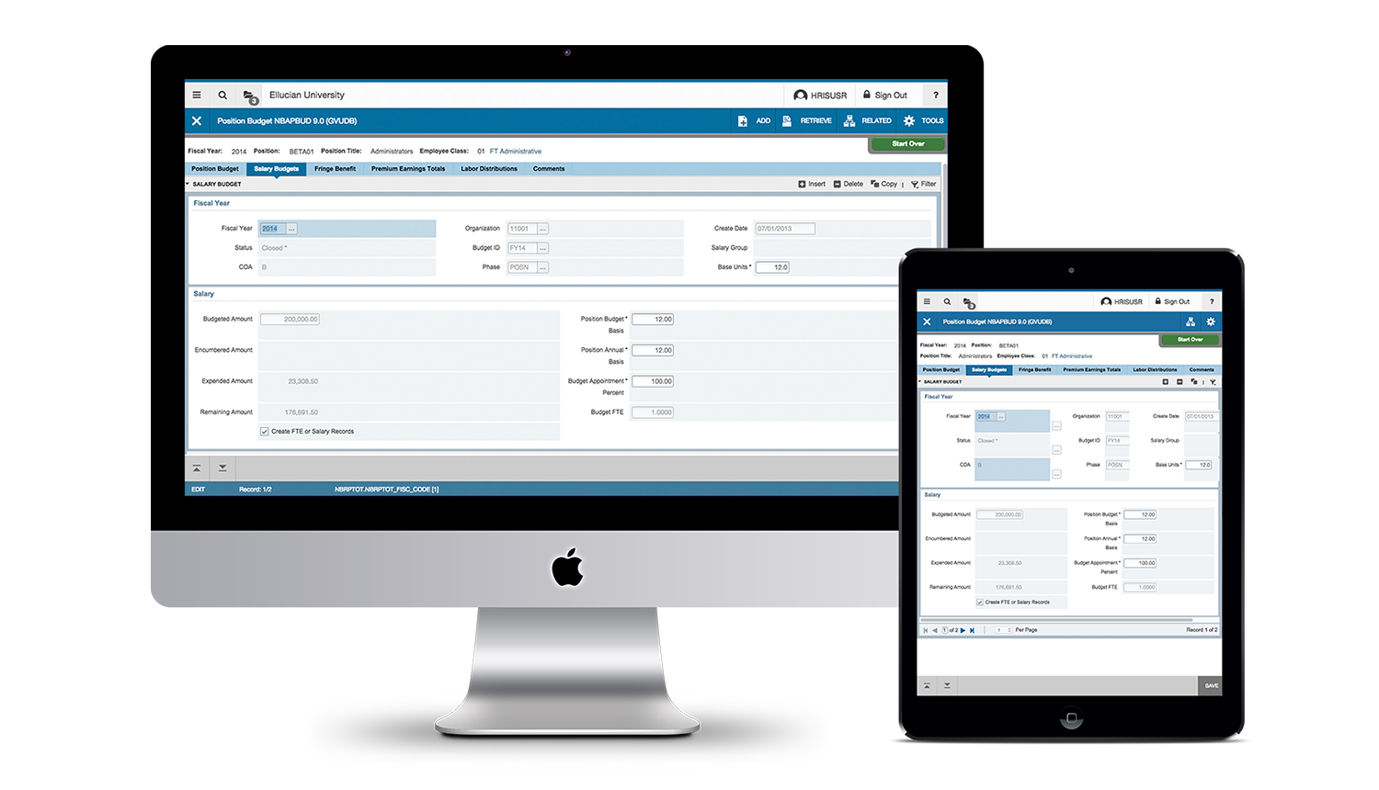
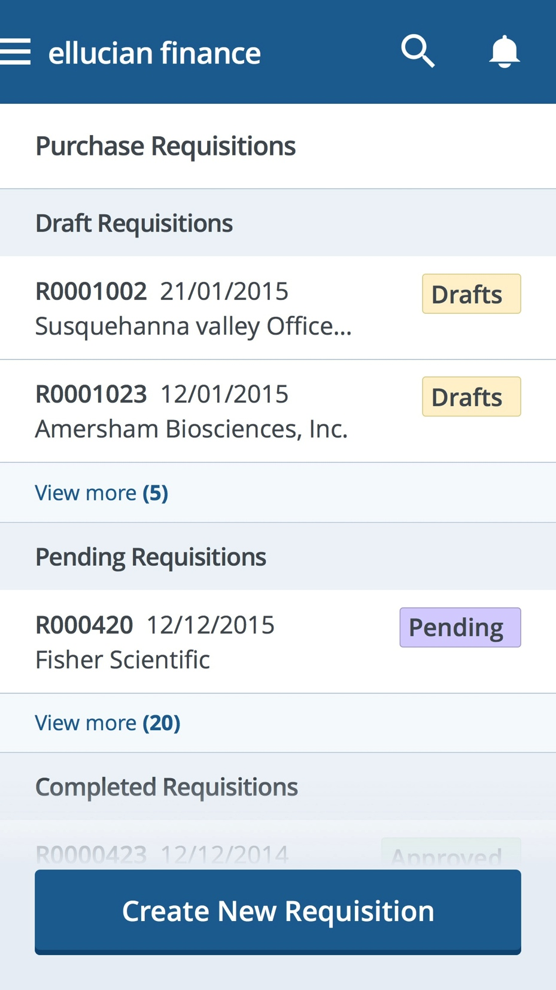
Banner 9’s New Look & Feel

Slide 8
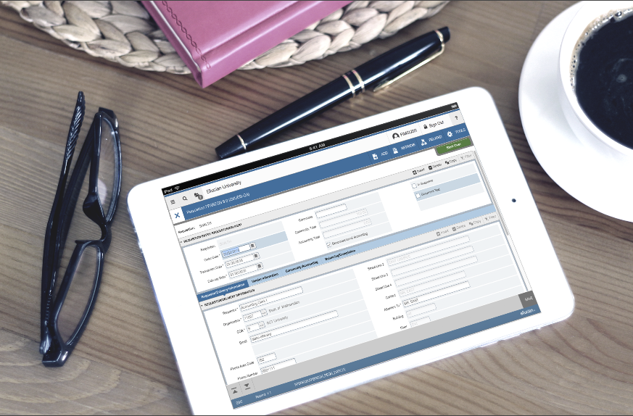
Tablet Friendly: Banner on-the-go

Slide 9
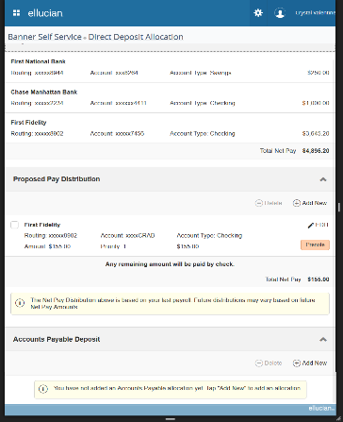
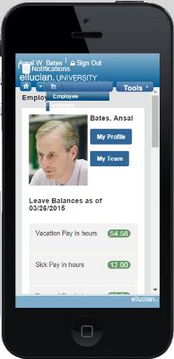
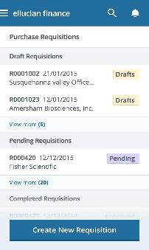
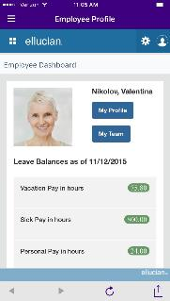
Supporting Constituents On The Go With All Devices
Ellucian Solutions Incorporate Mobility and Web 2.0 into administrative systems architecture
Watches
Tablets
Phones

Slide 10
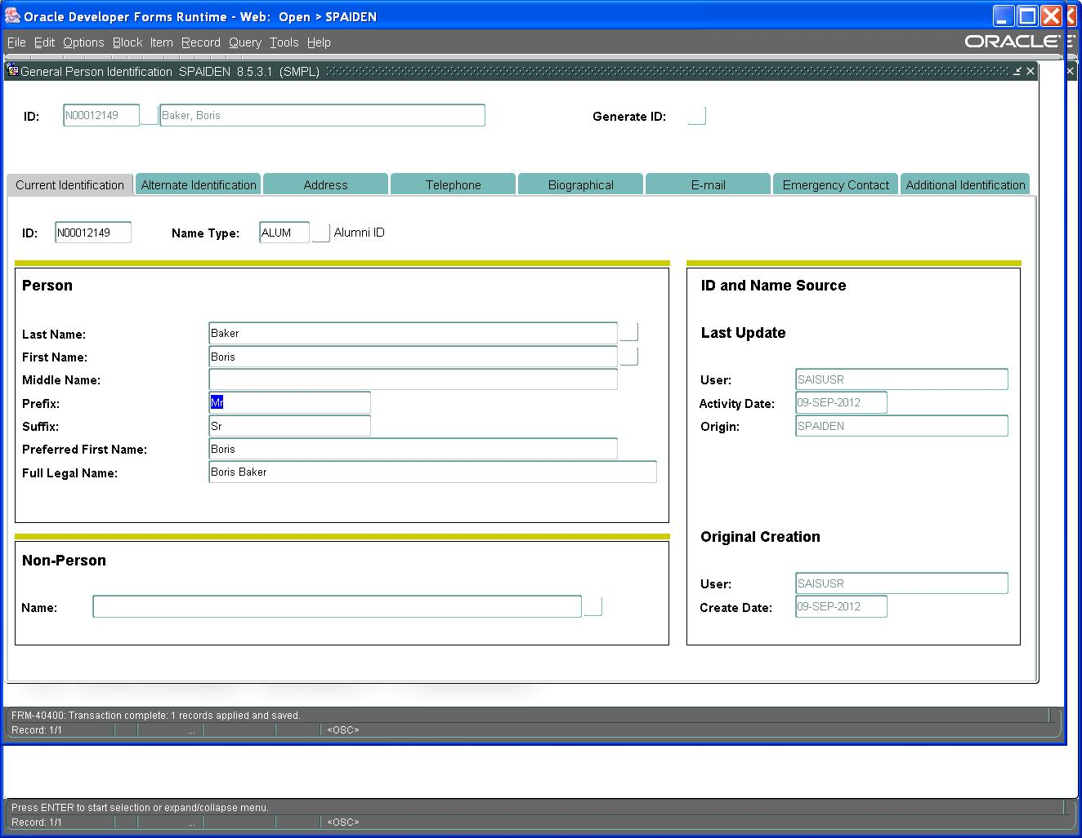
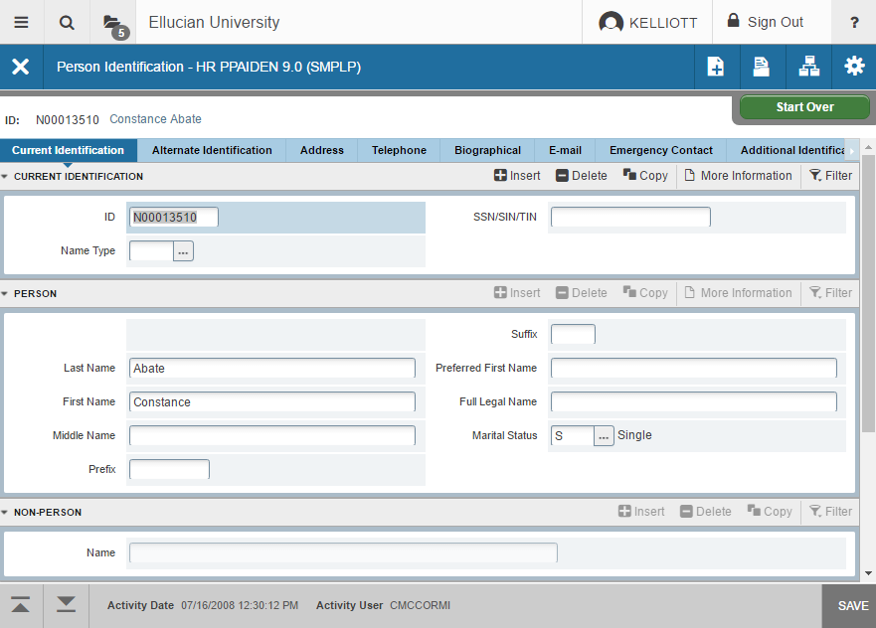
Release 9 Administrative Improvements
Old Oracle Forms
New Admin Transformed Page
Notes:
You can see the dramatic difference between how our Old Forms based on Oracle look versus the Transformed Pages.

Slide 11
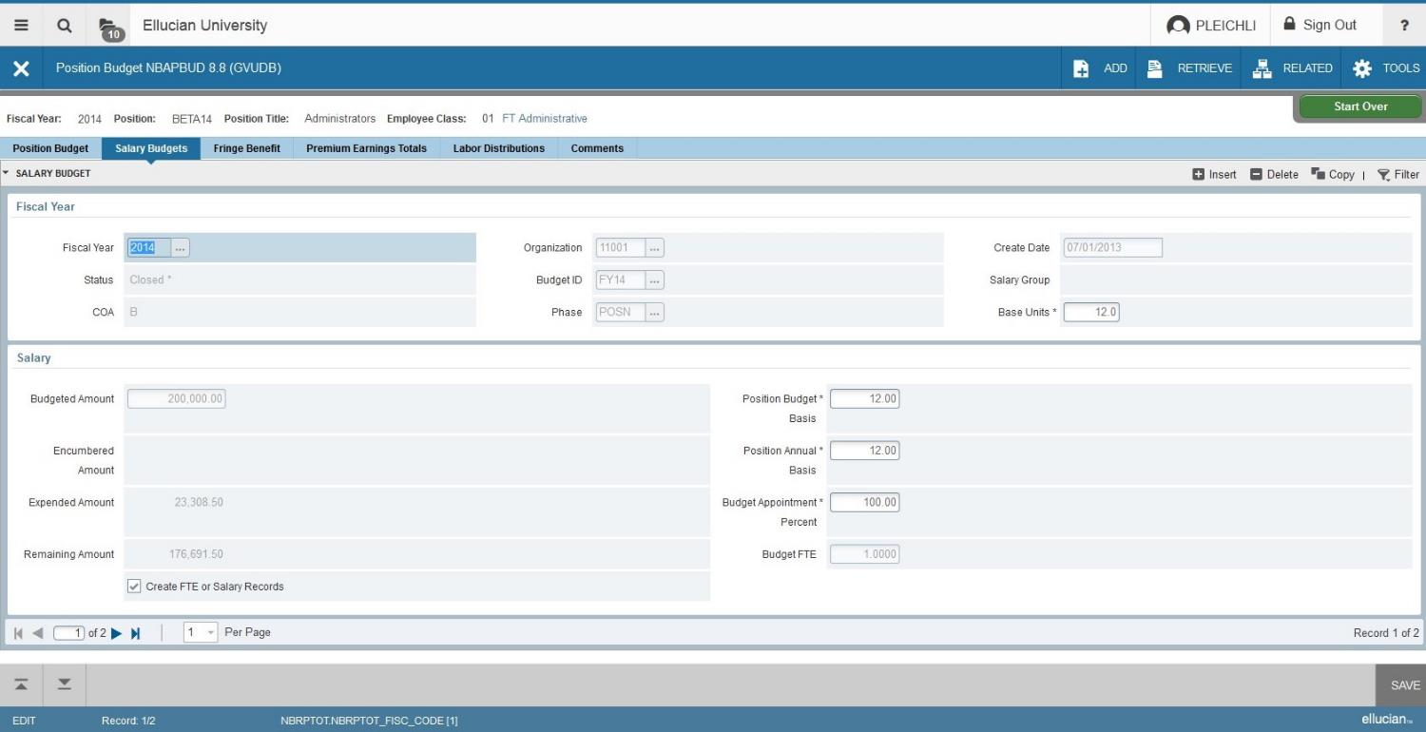
Enhanced User Interface
Standard tools and logout information.
Page navigation, total number of records and table and field information; can be used on tablet or desktop
Notes:
You can see navigational improvements with Standard tools always in the same place.
Page navigation and total # of records in the bottom left and table and field information always in the same place.

Slide 12
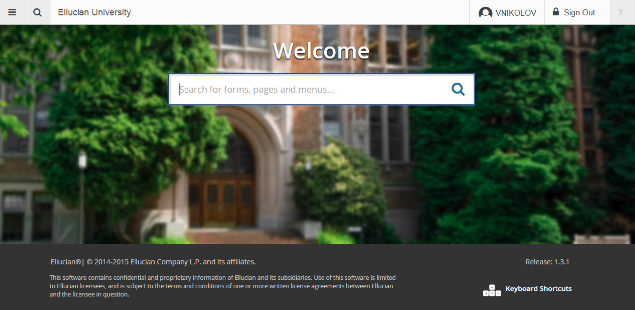
Application Navigation - Release 9 Administrative Improvements
Personalized Banner Admin Landing Page
Add your institution name
Search for and open new and legacy Banner forms using normal language or seven character abbreviation.
Set your own background image
Notes:
Application Navigator
Allows you to navigate between transformed Admin pages and Banner 8 forms
Ability to customize landing page

Slide 13
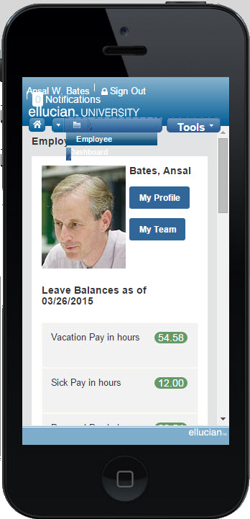
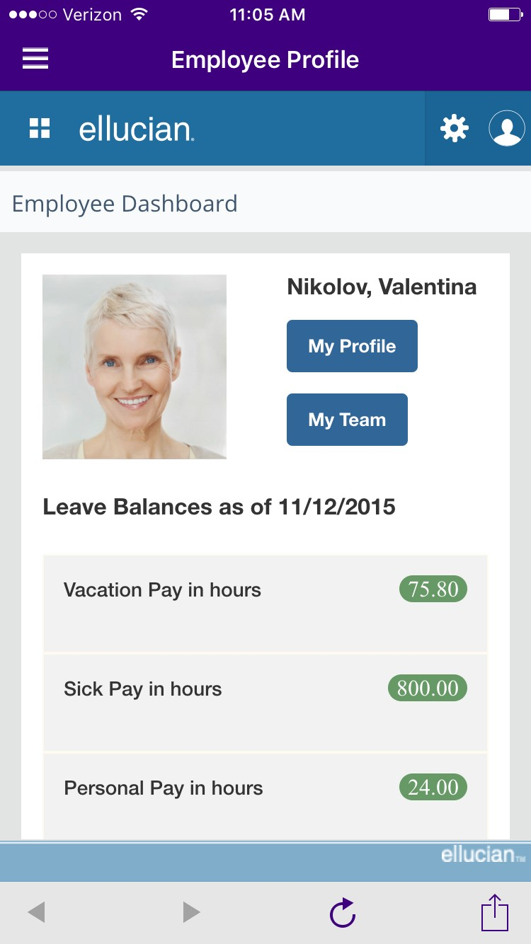
Employee Profile
Employee Profile – Mobile
Information is condensed and presented in a push instead of pull method
Supervisor access to team information
Enhanced usability, tablet and mobile ready
Notes:
Employee Self-Service: features a newly consolidated, easy-to-use dashboard that makes key personnel information readily and easily available. Best of all, it’s configurable, so you can turn features on and off according to your needs.
All-new, user-friendly components include: Employee Profile, Position Description, Labor Redistribution and Effort Reporting.
Employee Profile: An intuitive entry point for employees to access their personal, employment, and job-related information.

Slide 14
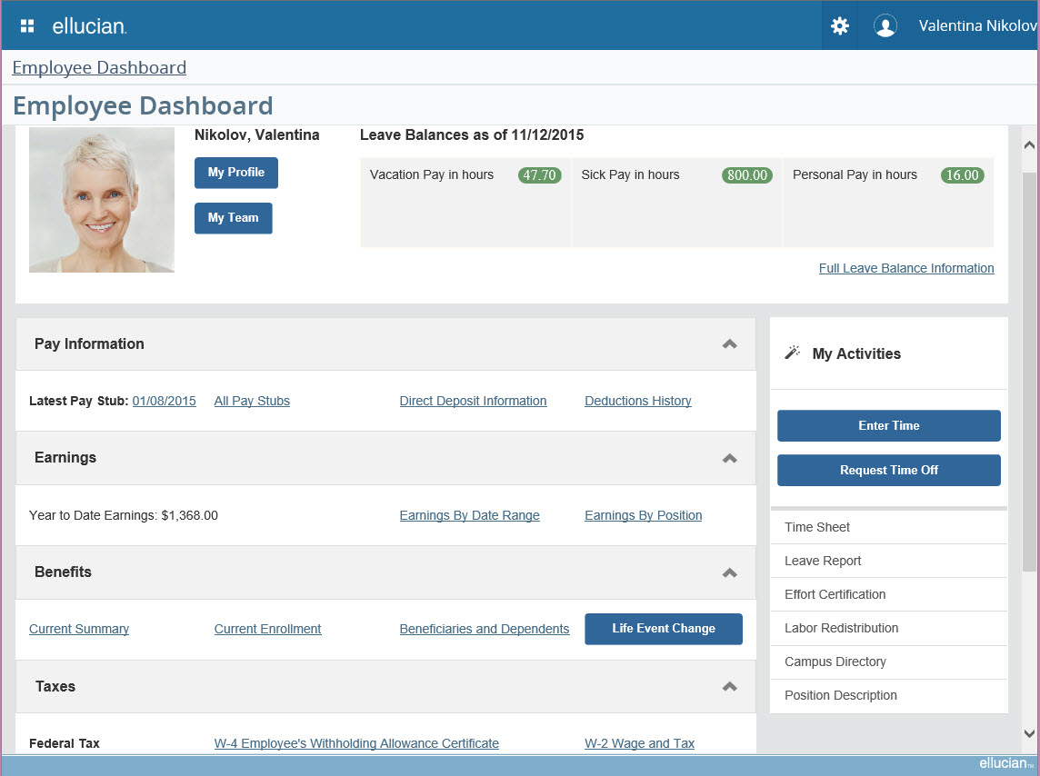
Employee Profile
Notes:
Employee Profile: An intuitive entry point for employees to access their personal, employment, and job-related information.
Here’s Employee Profile on a Tablet and larger screen

Slide 15
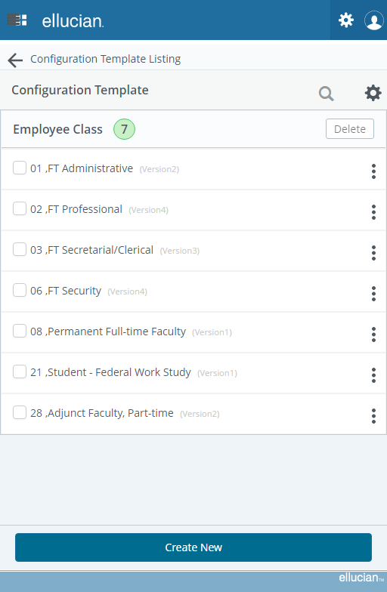
Position Description
A Position Description defines:
Duties and responsibilities
Requirements of a position
Uses include:
Library of position descriptions
Structured information to pass to other decision tools
Clear data to post job openings
Engage in for employee reviews or grievances
Succession planning
Reorganizations
Notes:
Position Description: A time-saving functionality for creating, editing, standardizing, routing, and approving position descriptions in Banner Human Resources, making posting on multiple job-search sites faster and more efficient.

Slide 16
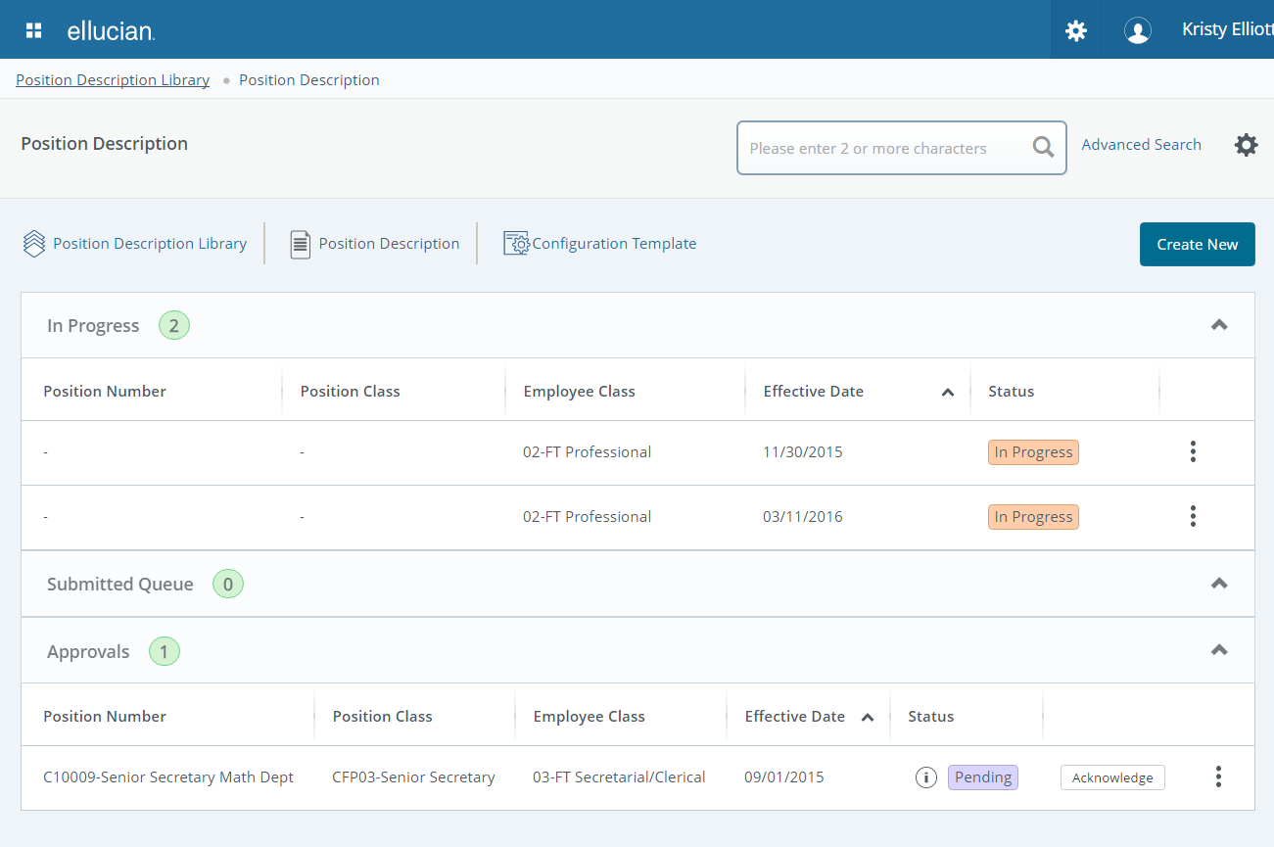
Position Description - Dashboard
Notes:
Upclose view of Position Description’s Dashboard
Position Description: A time-saving functionality for creating, editing, standardizing, routing, and approving position descriptions in Banner Human Resources, making posting on multiple job-search sites faster and more efficient.

Slide 17
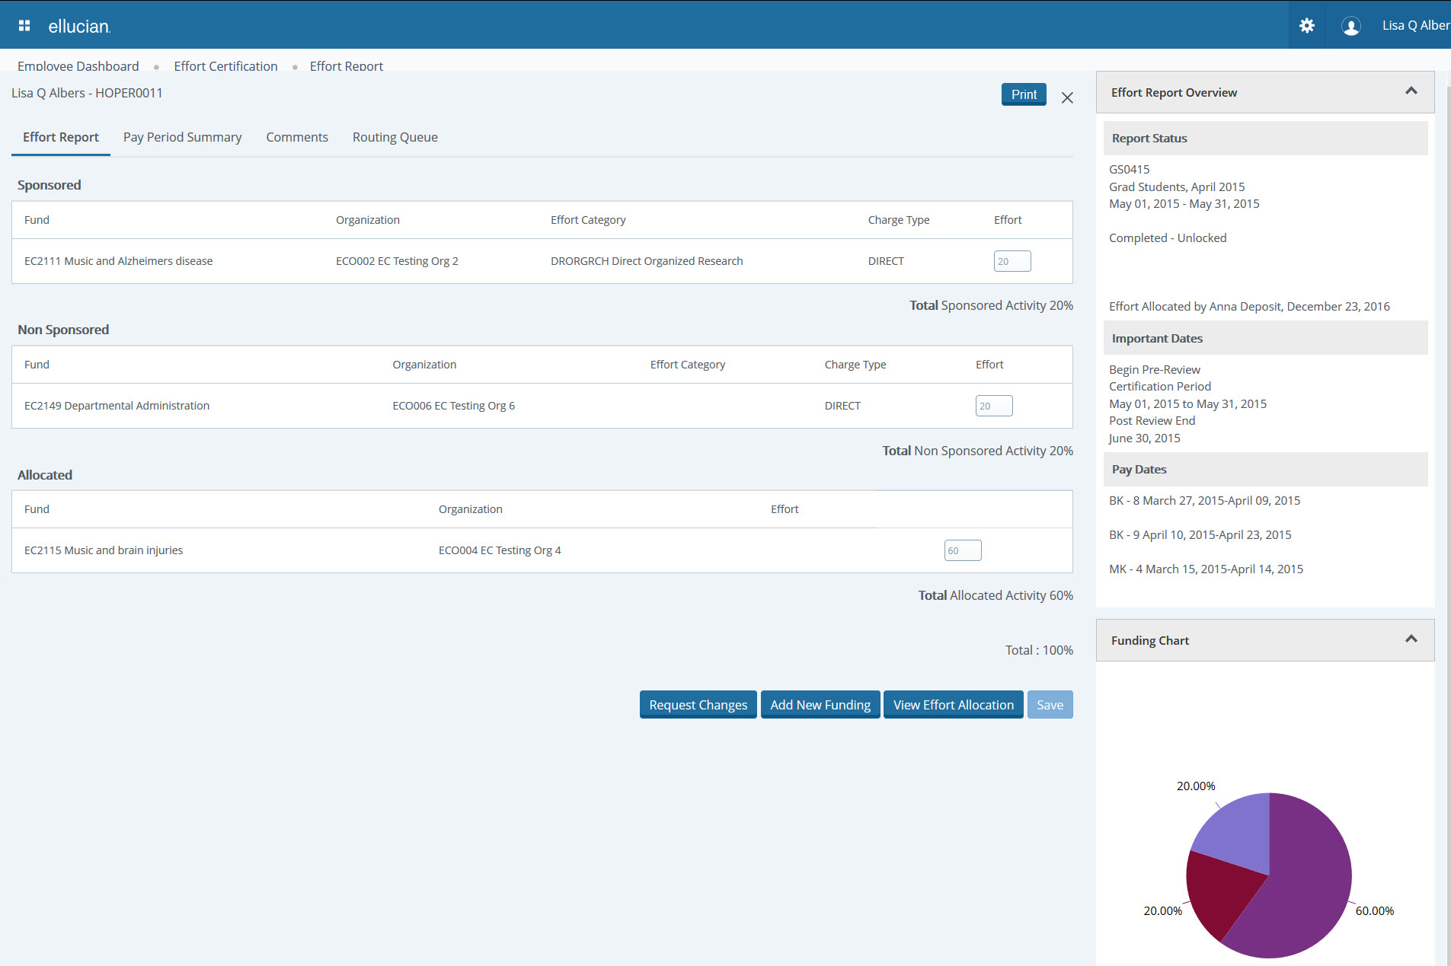
Enhanced Effort Reporting
Notes:
Part of the consolidated Employee Self Service application is: Effort Reporting: An efficient methodology for reporting on effort charged to grants and facilitating A-21 compliance. (For clients in the United States only.)

Slide 18
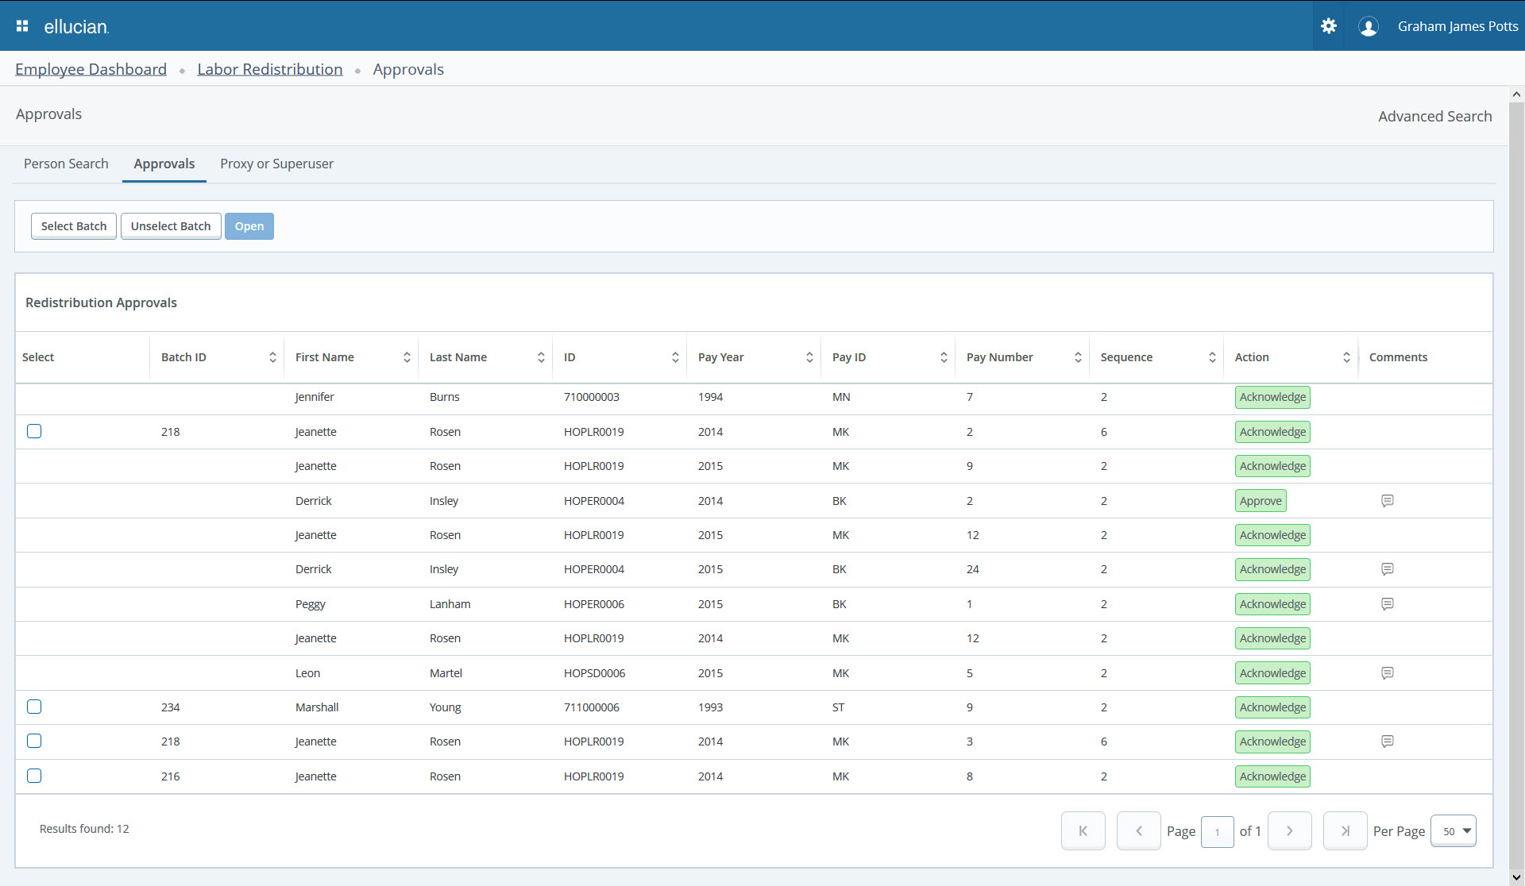
Streamlined Labor Redistribution
Notes:
Another part of the consolidated Employee Self Service application is:
Labor Redistribution: Essential tools for initiating a labor redistribution in Employee Self-Service, routing for approval, and maintaining history for audit purposes.

Slide 19
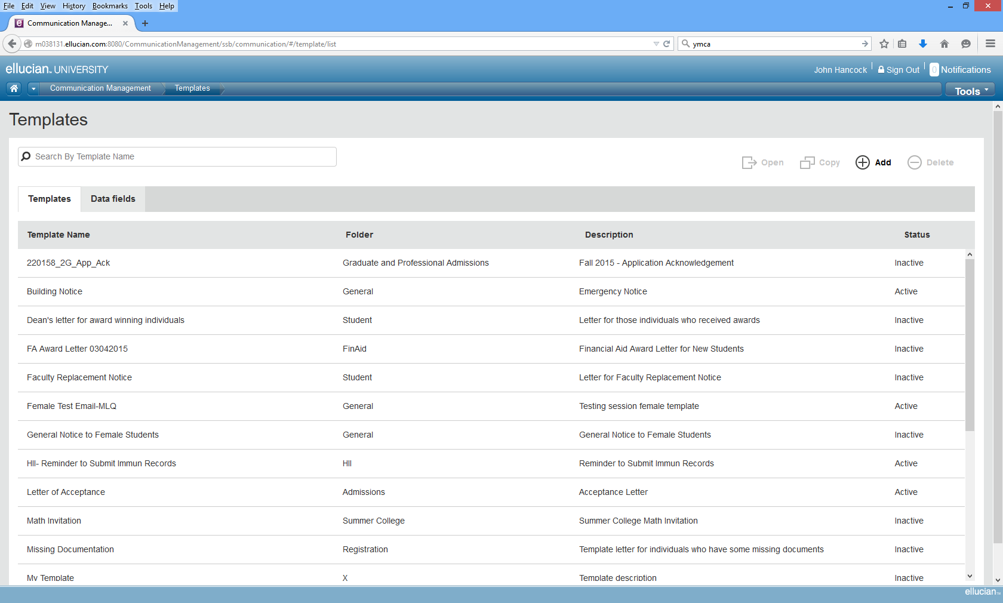
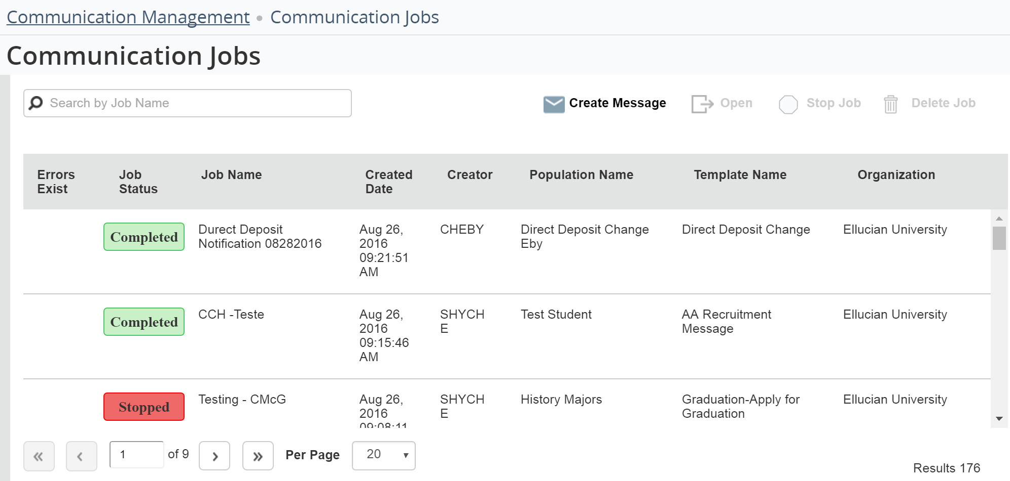
Communication Management
Key Features:
Features work across the Banner enterprise
Manages transactional connections to your constituents using Banner data
Set notifications or reminders to register for classes or when tuition is past due
Notes:
Communication management is a brand new functionality folks are really excited about. Communication Management offers all-new tools to helps you communicate with specific populations using Banner data. Communication Management makes it easy to create and send financial aid award letters, registration reminders, past-due tuition notices, and more.
It’s part of Banner General. It works across the entire Banner enterprise. You can communicate with any
Tactical and operational communications. It’s not a strategic communication platform but rather a process oriented platform. Communications you’d send to a subset of people like: “Your bill is due.” “You need to register.” “It’s time for benefits elections”

Slide 20
Expanding Banner 9 Functionality
Personal Information Self-Service
View, edit and update biographic and demographic information
Will display first/middle/last and preferred name in Personal Details, yet support name display differently in Overview section
Configurable using the Integration Configuration Settings (GORICCR) page
Direct Deposit and Personal Information functionality merged into single application
Easier to update and configure, by institution
Notes:
The functionality for Personal Information Self-Service has expanded.
You now can:
View, edit and update biographic and demographic information
Display a name in Personal Details (for the first, middle, last or preferred), yet support name display differently in Overview section
Configure the Integration Configuration Settings (GORICCR) page to your preference
Direct Deposit and Personal Information function has now merged into single application
It is overall easier to update and configure, by institution

Slide 21
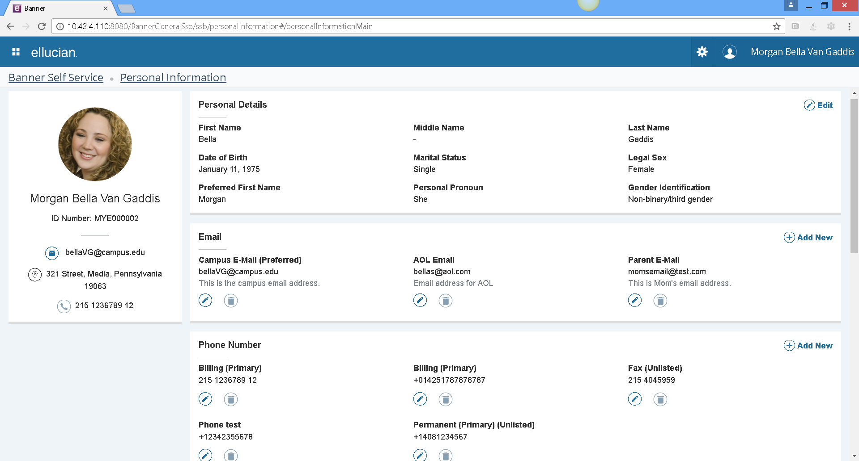
Personal Information Self-Service

Slide 22
What we’ve heard . . .
“The moment that I was able to sort on sequence number, then have the ability to replace the sequence numbers and save in one transaction, it was as if a light shined over my monitor with a faint chorus in the background. I was thrilled to see that improvement.”
Stephanie Boledovich, HR Systems Manager, Lansing Community College
“Employee Profile is a modern way of letting employees look at their own data and do their job and they can take it anywhere, because it is configured to work on any device – laptop, tablet and smartphone. Well done Ellucian! I love it. It is so easy to set up even a cave man can do it.”
Ali Penton, Software Application Engineer, University of West Florida
More stories on eCommunities
“We went actually live with Registration for our early registration for the following summer classes and it proved flawless. It worked with no problems and every review we’ve had has been positive.”
-Delano Sweeney, Database Systems Manager, Bluefield State College

Slide 23
Banner 9 Guide at www.ellucian.com/banner9guide See Ellucian Live videos on Banner 9 https://banner9guide.ellucian.com/content/ellucian-live-videos
Notes:
One primary resource is the Banner 9 Guide, which can be found online at ellucian.com/banner9guide
This site will continue to be your one stop shop for Banner 9 Upgrade content, so please ensure you have a HUB account and check back here as needed.

Slide 24
Places to Find More Information
Demos
Admin – Human Resources
Self Service - Employee Profile
eCommunities
Banner user community - Global Search feature that now pulls from eCommunities, the Ellucian Support Center and the Ellucian.com website
Attend an Ellucian education class
Notes:
Some great resources to check out.

